Slide 1

INT4001CEM: Software Design: User Story and Mapping
Photo by Fotis Fotopoulos on Unsplash
Shahriman Mohd Said

Slide 2
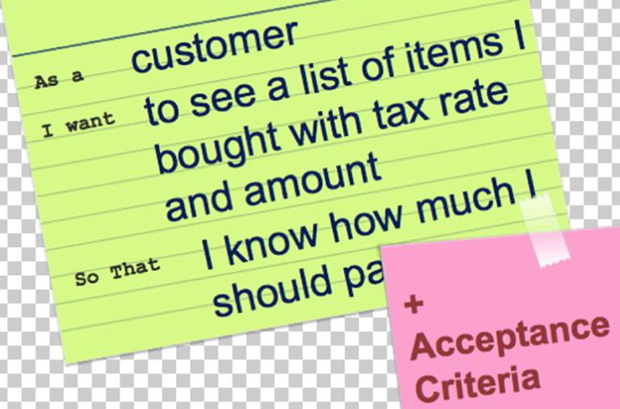
User Story
User Story:
a description of a software feature from an end-user perspective
a very high-level definition of a requirement
format:
As a <type of user>,
I want to <perform some task> ,
so that <achieve some goal>
Source : https://imgbin.com/

Slide 3
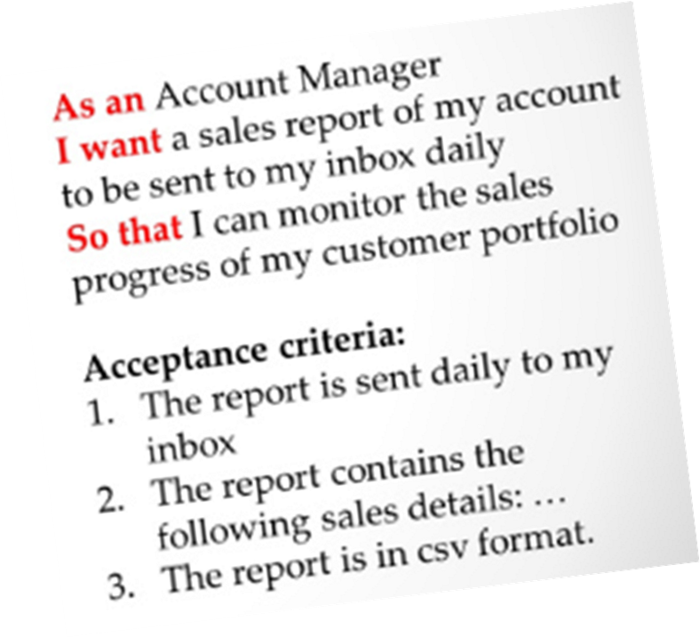
Acceptance Criteria
Acceptance Criteria:
describe conditions under which the user requirements are desired
served as the agreement between the team and the client
Source : https://leanagileguru.com

Slide 4
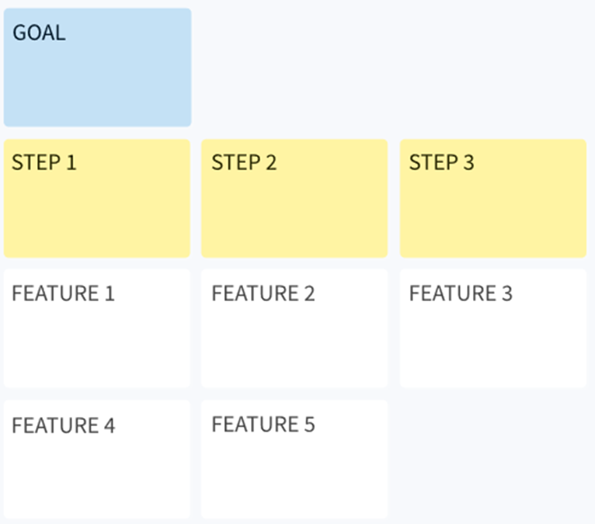
User Story Mapping
User story mapping:
Involves a series of steps and user stories as an iterative process to produce solutions to achieve their respective goals as below:
Goals
User steps
User stories with solutions (e.g. features)
releases
Source : www.storyboardthat.com/

Slide 5
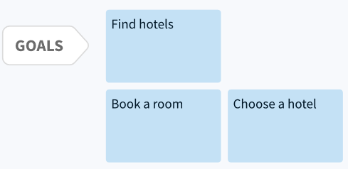
User Story Mapping
Example: Online hotel booking
Identify the goals
Source : www.storyboardthat.com/

Slide 6
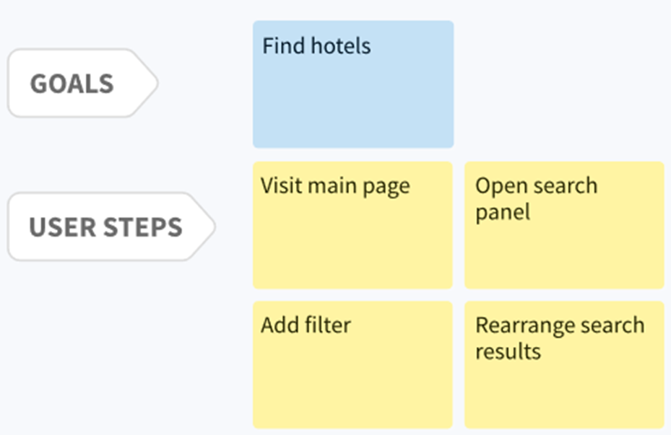
User Story Mapping
Example: Online hotel booking
Mapping the user steps to the goals
Source : www.storyboardthat.com/

Slide 7
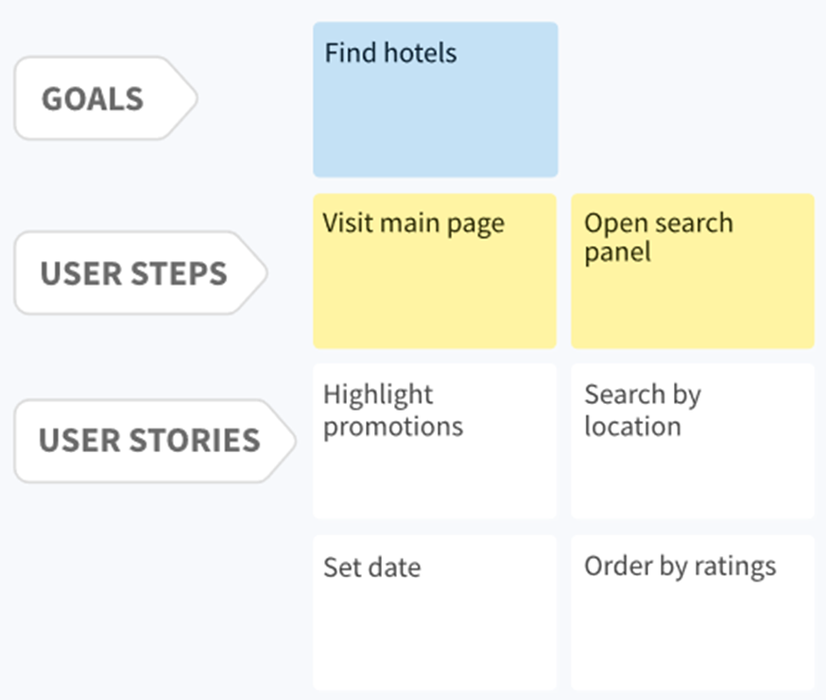
User Story Mapping
Example: Online hotel booking
Build the user stories for each user step and produce solutions
Source : www.storyboardthat.com/

Slide 8
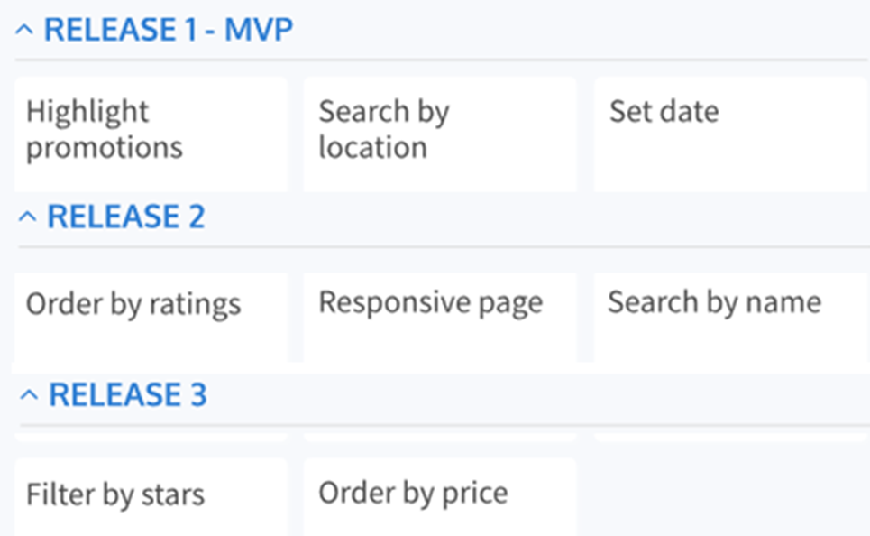
User Story Mapping
Example: Online hotel booking
Prioritise the solutions and plan releases
Source : www.storyboardthat.com/

Slide 9

Online Activity
To get a better understanding, please do Task 1 and Task 2 of the Online Activity for Week 1.

